Slide 1
GENERAL INFORMATION
Prepared by:
Christopher U. Palomares, LPT

Slide 2
Choose the sentence that expresses the thought clearly and that has no error in structure/spelling.
A. The farmer did plow, plant, harvest his corn in record time.
B. The farmer plowed, planted, and harvested his corn in record time.
C. The farmer has plowed, planted, and harvested his corn in record time.
D. The farmer plowed, has planted, and has harvested his corn in record time.

Slide 3
The traffic flow at the corner was jammed. Tom feared getting late so he _____ with a bus and leaped at the door.
A. catch up
B. was catching
C. caught up
D. has caught

Slide 4
Teacher Mae Ann always tries to help people, but recently she has been ____ kind and generous.
A. principally
B. usually
C. especially
D. largely

Slide 5
“I die just when the dawn breaks to herald the day.” This is a famous quote from _________.
A. Jose P. Rizal
B. Benigno Aquino
C. Jose Aquino
D. Manuel L. Quezon

Slide 6
Both Ruben and _____ plan to go.
A. I
B. me
C. myself
D. me myself

Slide 7
Your father is paying for your plane ticket, _____?
A. is he
B. isn’t it
C. aren’t you
D. isn’t he

Slide 8
We should work for a total ban _____ of pesticides that are harmful to man.
A. by the use
B. on using
C. with the use
D. on the use

Slide 9
Susan _____ in bed too long and missed her classes.
A. laid
C. lied
B. lays
D. lay

Slide 10
After 10 unfruitful years, Fe finally quit the job. She _____ along with her boss for a long time.
A. hasn’t been getting
B. didn’t get
C. hadn’t been getting
D. isn’t getting

Slide 11
Today, car manufacturers have begun to AUTOMATE their assembly lines by using robots. What does this trend mean?
A. Operate through machines
B. Cars are now automatic
C. Operates through human workers
D. Produce more efficient cars

Slide 12
She described her classmate’s statement as too SOPHOMORIC. This means ________.
A. grown up
B. mature
C. wise
D. immature

Slide 13
Is this the spot _____ had the accident?
A. wherein
B. where
C. why
D. which

Slide 14
If I ______ a Senator, I would live in Ayala village .
A. should be
B. am
C. were
D. was

Slide 15
_______ not making the most of _______ opportunities.
A. You’re - you’re
B. You - your
C. You’re - your
D. You’re – you

Slide 16
Which word does NOT mean the same as the other three?
A. furnish
B. defend
C. supply
D. equip

Slide 17
“Nothing that happens in this world ever happens by chance; it is all part of a grand design.” The author speaks of one’s _____.
A. destiny
B. luck
C. dream
D. ambition

Slide 18
It’s now two hours past his schedule, the facilitator may not come anymore, but we’ll still be ready in case he ______.
A. may
B. is coming
C. does
D. will come

Slide 19
The surprised teacher asked, “What was all the HUBHUB about? HUBHUB means ____.
A. hush
B. serenity
C. commotion
D. stillness

Slide 20
Who was the General who said “I shall return” after training troops in Australia?
A. Carlos P. Romulo
B. Douglas McArthur
C. J. de la Torre
D. G. Wainright

Slide 21
I should have returned the book last Tuesday; it is now five days _______.
A. delayed
B. postponed
C. overdue
D. beyond deadline

Slide 22
I saw a nasty _______ between two cars this morning.
A. happening
B. damage
C. accident
D. danger

Slide 23
Which passage is expressed effectively and without structural error/s?
A. I would not want to be themselves.
B. I would not want to be himself/herself.
C. I would not want to be he/she.
D. I would not want to be theirselves.

Slide 24
Which passage is expressed effectively and without structural error/s?
A. Having called the other students and they, the secretary went home.
B. Having called the other students and ourselves, the secretary went home.
C. Having called the other students and we, the secretary went home.
D. Having called the other students and us, the secretary went home.

Slide 25
Thomas Carlyle said, “The man without a purpose is like a ship without a rudder…” It could be interpreted as ___________.
A. there should be sufficient energy in one’s life.
B. direction can never come into one’s life.
C. one’s life doesn’t need to be controlled.
D. there is a strong driving force in one’s life.

Slide 26
Who said, “The Filipino is worth dying for?”
A. Benigno Aquino
B. Carlos P. Garcia
C. Fidel V. Ramos
D. Jose P. Rizal

Slide 27
Who is remembered for his famous quotation? “My loyalty to my party ends where my loyalty to my country begins.”
A. Carlos P. Garcia
B. Ferdinand Marcos
C. Manuel L. Quezon
D. Manuel Roxas

Slide 28
Which sentence clearly and effectively states the idea and has no structural error/s?
A. The interest at a loan company is higher than at bank.
B. The interest at a loan company is higher than a bank.
C. The interest of a loan company is higher than a bank.
D. The interest of a loan company is higher than in a bank.

Slide 29
Select the sentence that clearly and effectively states the idea and has no structural error/s.
A. The examinees need pencils, a calculator, and a ball pen.
B. The examinees need double pencils simply a calculator, and ball pen.
C. The examinees need two pencils, a simple calculator, and a ball pen.
D. The examinees need two sharpened pencils, a calculator, and ball pen.

Slide 30
There was HIATUS of two years before I went back to college. HIATUS means ____.
A. lapse
B. uninterruption
C. length
D. continuation

Slide 31
I was speaking to Ana on the phone when suddenly we were __________.
A. disconnected
B. cut off
C. hung up
D. broken down

Slide 32
“The Lord is my shepherd; I shall not want” is an expression of one’s _________.
A. total poverty
B. blind ignorance
C. love for self
D. total submission to God

Slide 33
Which passage is expressed effectively and without structural error/s?
A. The teacher explained that the Mean Percentage Score (MPS) of high school students in English was much lower than it has been in previous years.
B. The teacher explained that the Mean Percentage Score (MPS) of high school students in English was much lower than the previous years.
C. The teacher explained that the Mean Percentage Score (MPS) of high school students in English was much lower than it had been in previous years.
D. The teacher explained that the Mean Percentage Score (MPS) of high school students in English was lowest than the previous years.

Slide 35
“Ang mga mata mo ay tulad ng mga bituin sa kalangitan.” Ano ang ginagamit na pagpapahayag dito?
A. Pagtutulad
B. Personipikasyon
C. Pagwawangis
D. Pang-uyam

Slide 36
Huwag limutin ang vernacular. Tutuhing iasimila ito sa pambansang wika sa ikauunlad ng kultura at lahi. Ang ibig sabihin ng iasimila ay ________.
A. papaunlarin
B. papakinabangan
C. pagyamanin
D. papayabungin

Slide 37
Alin ang nagbibigay ng opinion tungkol sa isang napapanahong isyu sa pamamagitan ng larawan?
A. Kartong pang-editoryal
B. Ilustrasyong karikatyur
C. Larawan sa unang pahina
D. Larawan sa huling pahina

Slide 38
Alin ang salawikain sa mga sumusunod:
A. May puno walang bunga, may dahon walang sanga.
B. Di maliparang uwak.
C. Nagbubuhat ng sariling bangko.
D. Nasa Diyos ang awa, nasa tao ang gawa.

Slide 39
“Matagal nang lumagay sa tahimik si Mely.” Ang ibig sabihin ay:
A. Nanahimik na.
B. Nag-asawa na.
C. Lumisan na.
D. Namatay na.

Slide 40
Sa taas ng mga bilihin ngayon, kahit “kahig ka ng kahig” ay wala pa ring maipon. Ano ang ibig sabihin nito?
A. Hindi bumili
B. Hanap ng hanap
C. Bawasan ang bili
D. Gastos ng gastos

Slide 41
Anong bahagi ng pananalita ang nasa malaking titik? Malungkot ANG MGA nagtapos na wala pang trabaho.
A. Pananda
B. Parirala
C. Pang-ukol
D. Pangatnig

Slide 42
“Kung anong bukambibig siyang laman ng dibdib.” Ito ay isang uri ng _________.
A. tula
B. tugmaan
C. bugtong
D. salawikain

Slide 43
Ano ang kahulugan ng tagbising panahon?
A. tag-ulan
B. tag-init
C. tag-lamig
D. tag-tuyot

Slide 44
Ang salitang apartment ay binubuo ng dalawang klaster. Tukuyin ito.
A. rt at tm
B. pr at tm
C. tm at nt
D. rt at nt

Slide 45
Ang butong tinangay ng aso walang pagsalang nalawayan nito. Ang kaisipang ito ay tumutukoy sa katotohanan ng:
A. pagnanakaw
B. pakikipagkaibigan
C. pagpapakain
D. pagtatanan

Slide 46
Alin sa mga ito ang nagpapahayag sa paraang organisado at artistiko maging tuluyan o sa berso na nagmula sa imahinasyon?
A. panulaan
B. epiko
C. sanaysay
D. panitikan

Slide 47
Mag-aalas singko na _____ umaga _____ magising siya.
A. ng-nang
B. nang-kapag
C. nang-nang
D. ng-at

Slide 48
Sino ang nangungusap sa quotation? “Ang pag-ibig ay hindi pag-ibig kapag nagbabago kung nakakakita ng pagbabago.”
A. Genoveva Matute
B. William Shakespeare
C. Robert Frost
D. Jose Rizal

Slide 49
Ponema ang tawag sa makabuluhang tunog ng wika. Ilan ang ponema ng Filipino?
A. 28
B. 31
C. 20
D. 21

Slide 50
Saan hinango ang mga kwentong tinatawag na parabula?
A. Mga pinagmulan
B. Kasabihan
C. Bibliya
D. Kwentong bayan

Slide 51
Alin dito ang ginagamit sa pagtuturo ng panitikan lalo na sa pagkasunod-sunod ng mga pangyayari sa kwento?
A. Story grammar
B. Decoding
C. Character web
D. Story frame

Slide 52
Alin dito ang gamit sa pagtuturo na replika na yari sa isang tunay o sintetik na material?
A. dayorama
B. ispesimen
C. papet
D. mock-up

Slide 53
Ano ang kahulugan ng idyomang ginamit sa pangungusap na “Marami sa mga magsasaka ang INALAT dahil sa patuloy na pagbuhos ng ulan”?
A. Nawalan ng pag-asa
B. nanibago
C. nagalit
D. minalas

Slide 54
Mapangarapin ang maliliit! Ang ibig sabihin ng pahayag na ito ay ang mga taong mahihirap ay __________.
A. Nais umangat sa buhay kaya nakikipagsapalaran
B. May pangarap na guminhawa
C. Nananaginip ng gising
D. Gustong lumipad sa alapaap

Slide 55
Aling pamaraan ang ginagamit ng guro na nagsisimula sa mga halimbawa patungo sa paglalahat?
A. Pabalak
B. Pasaklaw
C. Patuklas
D. Pabuod

Slide 56
In a certain school, the ratio of boys to girls is 3 to 7. If there are 150 boys and girls in the school, how many boys are there?
A. 105
B. 90
C. 45
D. 75

Slide 57
One angle of a parallelogram is 35. What are the measures of the other three angles?
A. 45°, 65°, 170°
B. 85°, 135°, 140°
C. 145°, 35°, 145°
D. 35°, 65°, 65°

Slide 58
The edges of a rectangular solid have these measures: 1.5 ft x ½ ft x 3 inches. What is its volume in cubic inches?
A. 324
B. 225
C. 272
D. 27

Slide 59
A water tank contains 8 liters when it is 20% full. How many liters does it contain when it is 75% full?
A. 60
B. 30
C. 58
D. 15

Slide 60
Which of the following has the largest value?
A. 7⁵
B. 3⁹
C. 6⁴
D. 9³

Slide 61
How many degrees are between the hands of a clock at 3:40?
A. 140°
B. 130°
C. 125°
D. 150°

Slide 62
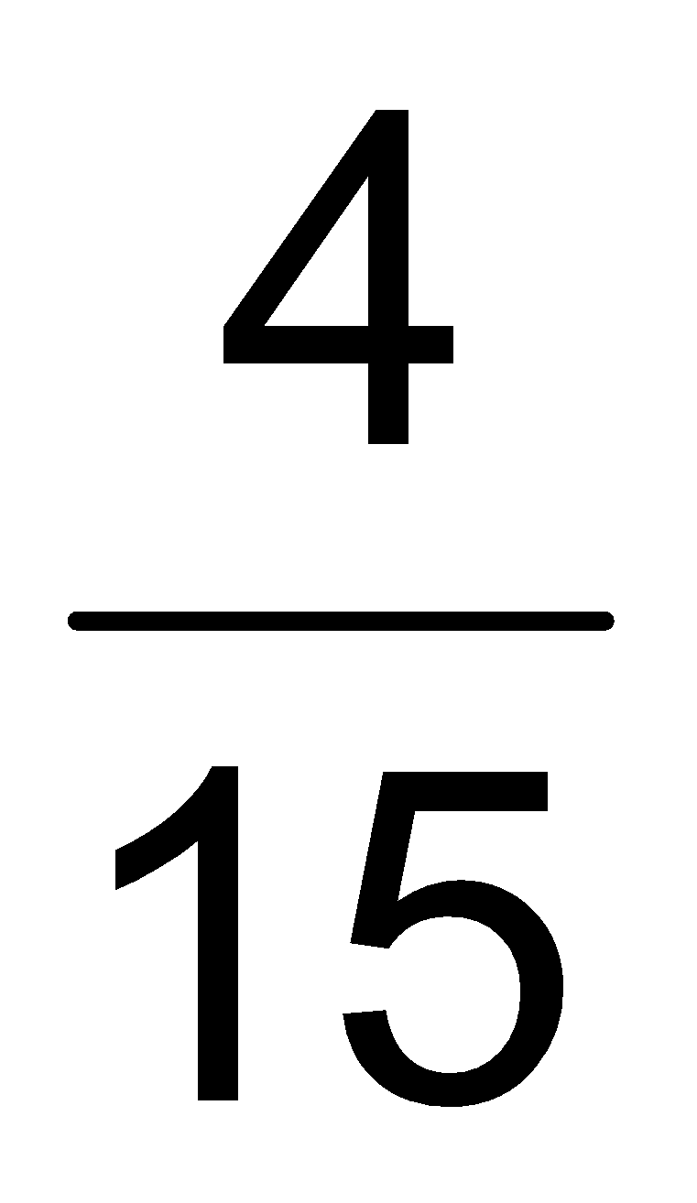
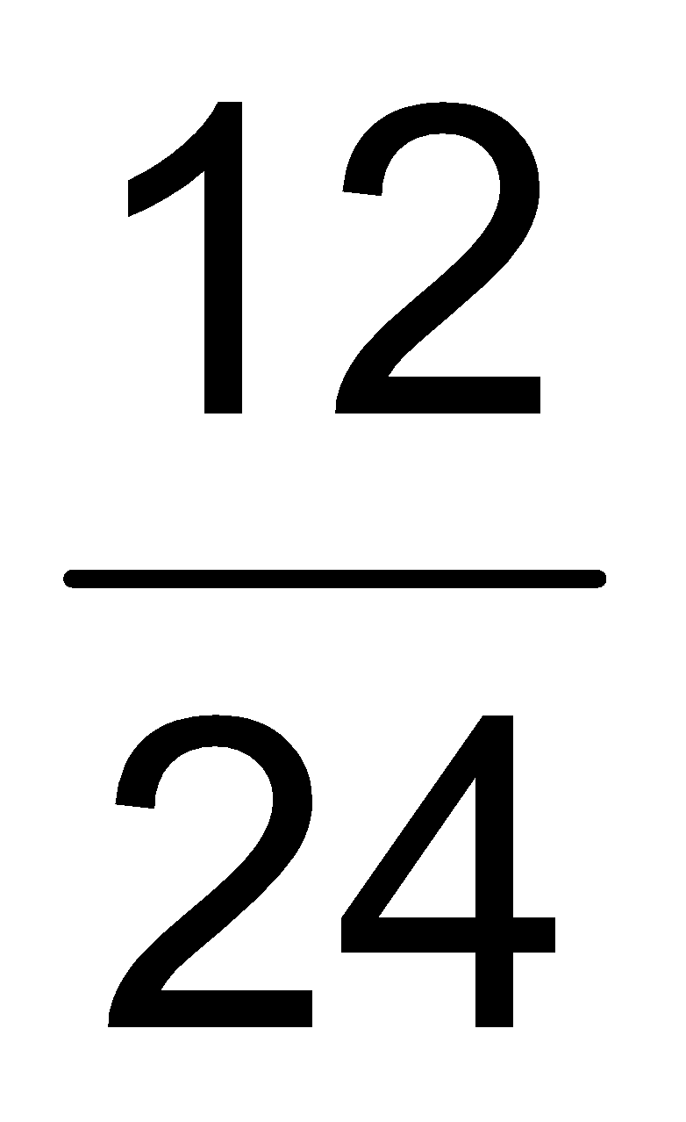


Which of these three fractions has the largest value?
A.
C.
B.
D.

Slide 63
If x = 3 and y = 2, then 2x + 3y = ______.
A. 12
B. 10
C. 14
D. 5

Slide 64

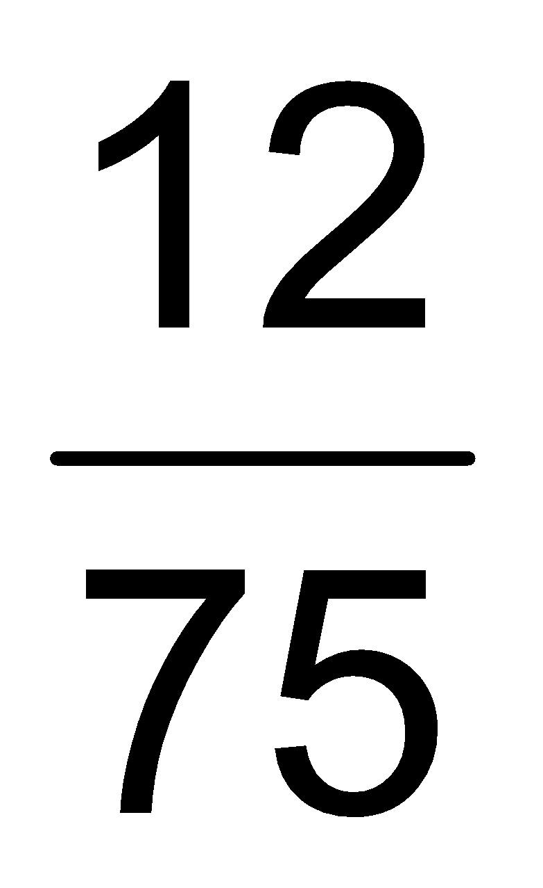
Which of these has a value different from the other three?
A. 15%
C. .15
B.
D.

Slide 65
The vertex angle of an isosceles triangle is 30°. What is the measure of one of the base angles?
A. 150°
B. 60°
C. 75°
D. 70°

Slide 66
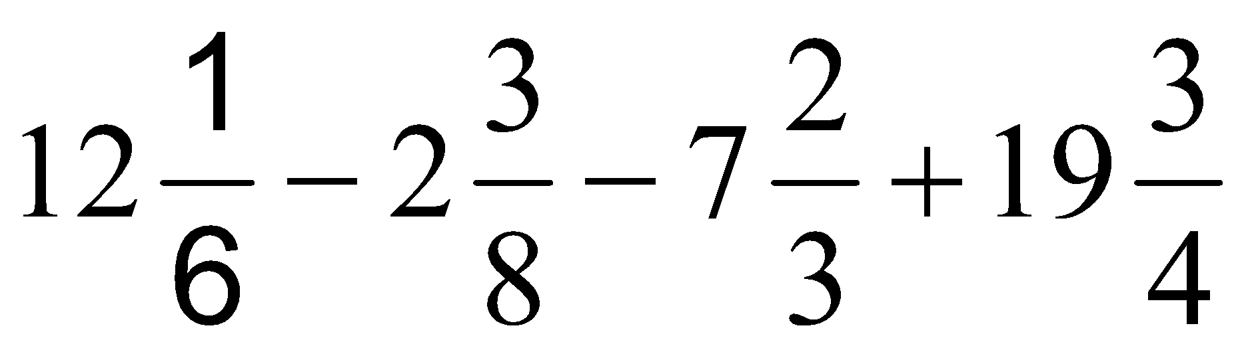
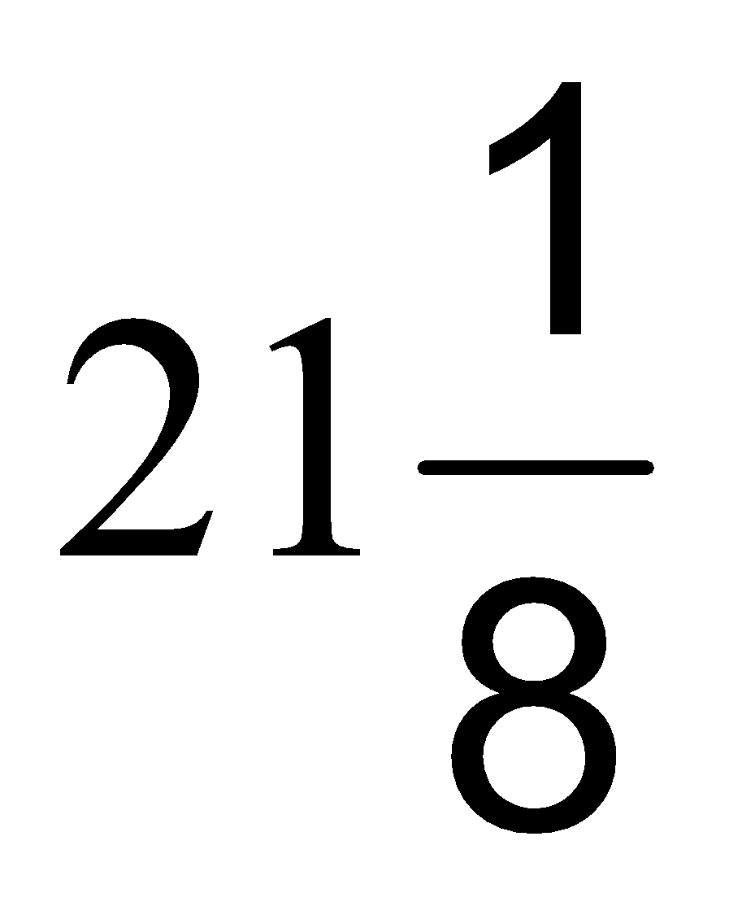
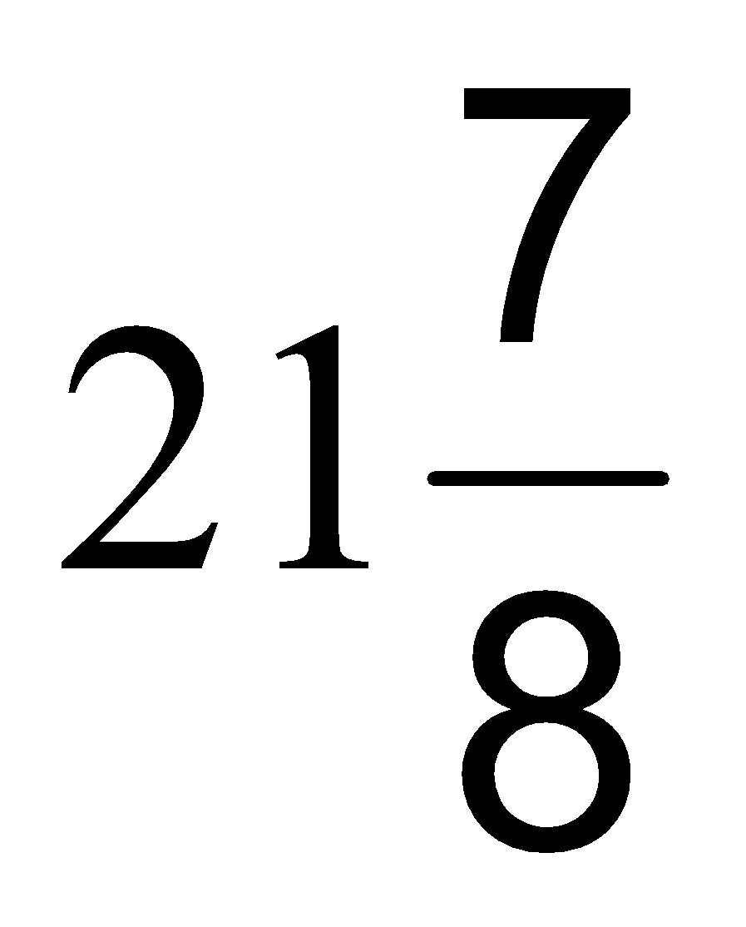
What is the value of ?
A.
C.
B. 22
D. 21

Slide 67
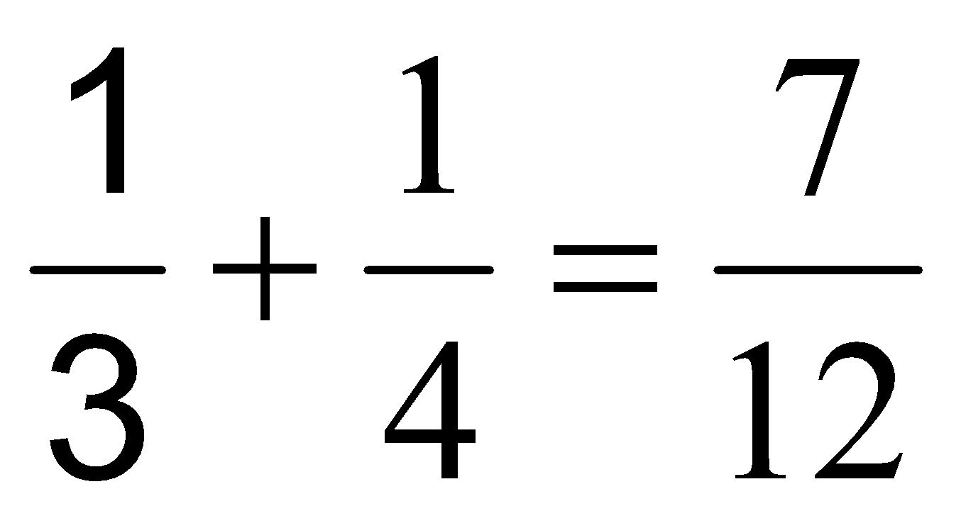
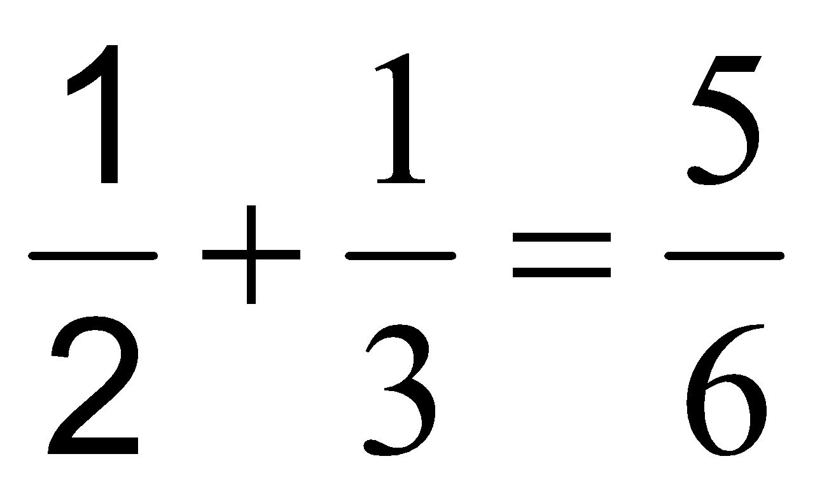
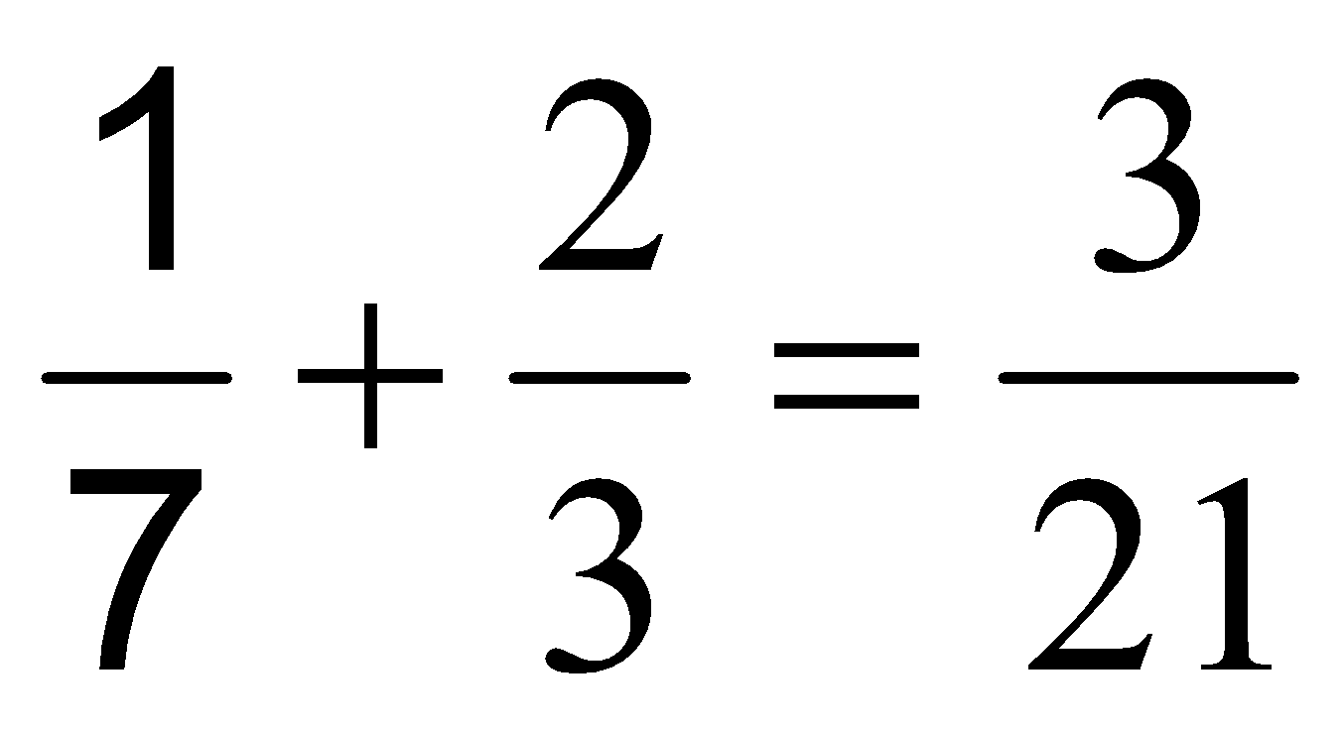
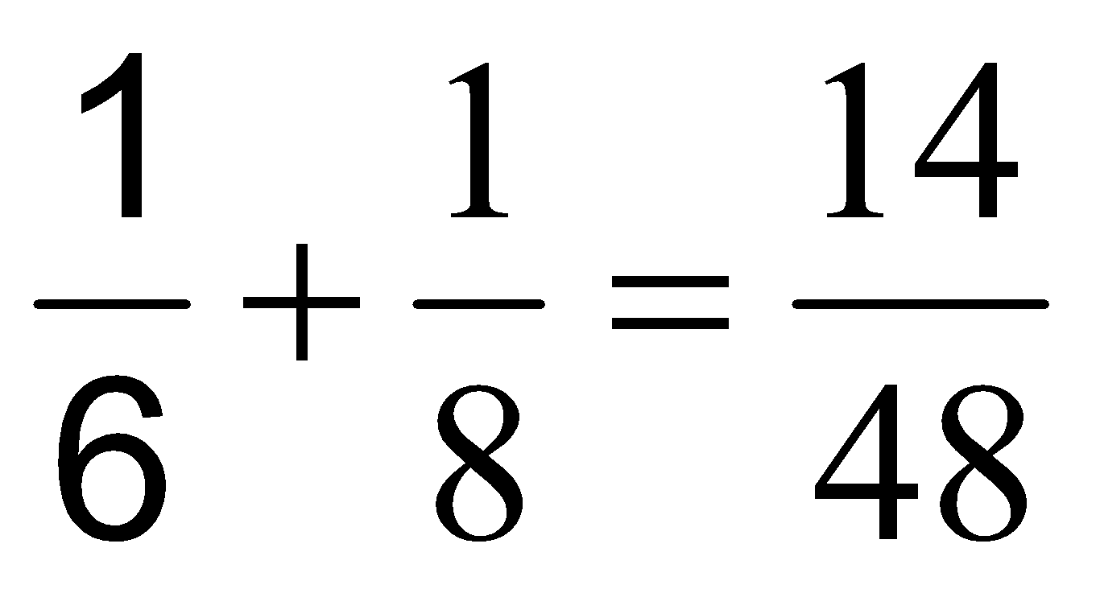
Which of these math sentences is NOT CORRECT?
A.
C.
B.
D.

Slide 68
Joseph is 10 years older than his sister. If Joseph was 25 years of age in 1983, in what year could he have been born?
A. 1948
B. 1963
C. 1958
D. 1953

Slide 69
Joseph is 10 years older than his sister. If Joseph was 25 years of age in 1983, in what year could he have been born?
A. 1948
B. 1963
C. 1958
D. 1953

Slide 70
What number is next in this sequence? 11120, 11260, 11420, 11600
A. 11820
B. 11760
C. 11720
D. 11800

Slide 71
If the counting numbers 1 to 30 are written down, how many times does the digit 2 appear?
A. 11
B. 14
C. 12
D. 13

Slide 72
259:37 as ______.
A. 84:12
B. 25:4
C. 5:1
D. 63:441

Slide 73
What value of x will make this proportion correct? 13:x = 3.25:8.00
A. 2
B. 3.5
C. 32
D. 20

Slide 74
How many glasses of Cola each to be filled with 150 cu.cm. of liquid can be made from 5 family size bottles of cola each containing 1.5 liters?
A. 45
B. 50
C. 60
D. 40

Slide 75
What is the greatest common factor of the numbers 48, 12, and 32?
A. 2
B. 4
C. 3
D. 6

Slide 76
A car depreciates by 10% of its brand new price each year and by 15% in each succeeding year. By 2009, what would be the market price for a car bought brand new for P600,000 in 2004?
A. P390,000
B. P480,000
C. P210,000
D. P420,000

Slide 77
By how much is 35% of P220 greater than 55% of P140?
A. P10.00
B. P0.00
C. P20.00
D. P16.00

Slide 78
In the playground for kindergarten kids, 18 children are riding tricycles or bicycles. If there are 43 wheels in all, how many tricycles are there?
A. 7
B. 8
C. 9
D. 11

Slide 79
The edges of a cubical frame are made from plastic straws. How much longer is the total length of the plastic edges of a cube whose edges is 10cm compared to a cube whose edge is 8cm?
A. 24 cm
B. 32 cm
C. 16 cm
D. 8 cm

Slide 80
In a Mathematics test, 35 students passed and 30% failed. How many students took the test?
A. 60
B. 50
C. 40
D. 30

Slide 81
The legs of one right triangle are 9 and 12, while those of another right triangle are 12 and 16. How much longer is the perimeter of the larger triangle than the perimeter of the smaller triangle?
A. 84
B. 14
C. 7
D. 12

Slide 82
Each bag contains 50 kg. What would be the increase in the price if the cost of one bag of rice goes from P950.00 to P1,200.00?
A. P250.00
B. P7.50
C. 3.75
D. P5.00

Slide 83
At what rate of interest should P2,400 be invested so that it will earn P880 in 8 months?
A. 6 ½%
B. 5 ½%
C. 5%
D. 6%

Slide 84
In the following number, which digit is in the thousandths place? 5672.13498
A. 6
B. 4
C. 3
D. 9

Slide 85
A child can be admitted to Grade 1 if he/she is at least 5 years and 10 months old by June of the school year. Which of these dates of birth will DISQUALIFY a child from being admitted to Grade 1 on June 15, 2009?
A. June 10, 2003
B. Jan. 10, 2003
C. April 30, 2003
D. May 5, 2003

Slide 86
How much greater is the sum of the first 20 counting numbers greater than the sum of the first 10 counting numbers?
A. 110
B. 55
C. 155
D. 100

Slide 87
Which of these numbers CANNOT possibly be a square number?
A. 10217356
B. 35366809
C. 26275876
D. 2916488

Slide 88
Which number is wrong in this sequence? What should the number be for the sequence to be CORRECT? 5, 15, 16, 48, 144, 147, 148, 444…
A. 48; it should be 18
B. 147; it should be 145
C. 144; it should be 132
D. 144, it should be 49

Slide 89
If July 12, 2003 fell on a Tuesday, on what day will July 12, 2005 fall?
A. Monday
B. Thursday
C. Sunday
D. Friday

Slide 90
How many vertices does a rectangular solid have?
A. 8
B. 6
C. 4
D. 12

Slide 91
Which statement is FALSE?
A. Solid particles have the strongest attractive forces in between.
B. Solids and liquids have more molecules per unit volume, hence their densities are higher.
C. Molecules of solids and liquids are more closely packed than those in gases.
D. The gas phase has the least kinetic energy.

Slide 92
Which has the higher specific heat capacity: water or sand?
A. Neither sand nor water
B. Sand
C. Both
D. Water

Slide 93
The direct transformation of a solid into the gas phase without passing through the liquid phase is called:
A. Sublimation
B. Compression
C. Evaporation
D. Freeze drying

Slide 94
Why is it NOT advisable to repeatedly open the door of a refrigerator?
A. It will loosen the hinges of the refrigerator’s door.
B. It leads to wastage in electrical energy.
C. Repeated opening introduces bacteria into the refrigerator.
D. The warm air outside lowers the temperature inside, thus, making the refrigerator less efficient.

Slide 95
What may occur when there is a severe damage to some parts of the brain due to lack of blood supply?
A. Stroke
B. Rheumatic heart
C. Heart attack
D. Thrombosis

Slide 96
What kind of mirror is used in cars to give the driver a wider area and smaller image of the traffic behind him/her?
A. Double concave
B. Convex
C. Plane
D. Concave

Slide 97
When you carry a heavy load with one arm, you tend to hold your free hand away from your body in order to ________.
A. Be ready to grab something in case you fall
B. Change the weight of your body and load
C. Change the mass of your body
D. Change the center of gravity of your body and load

Slide 98
You inherited tallness from your father. Physical traits are transmitted from parents to offsprings through __________.
A. alleles
B. genes
C. gametes
D. chromosomes

Slide 99
Which is a destructive fishing method wherein fishes are driven out of a coral reef by pounding the corals with a heavy weight?
A. Muro-ami
B. Cyanide fishing
C. Reef fishing
D. Corals entrapping

Slide 100
The prevailing wind systems experienced in the Philippines are __________.
A. Northwest and southwest monsoon
B. East and west monsoon
C. Northeast and Southwest monsoon
D. North and South monsoon

Slide 101
Jane placed some mothballs inside her cabinet. After a week, they were all gone. What happened to the mothballs?
A. They were dissolved by water in air.
B. They melted.
C. They sublimed.
D. They condensed.

Slide 102
Of the state of matter, which has the weakest intermolecular force of attraction?
A. Plasma
B. Liquid
C. Solid
D. Gas

Slide 103
To be safe in the unlikely case of lightning strike, it is best to be inside a building framed with ______.
A. steel
B. cement
C. iron
D. wood

Slide 104
Which of these does NOT belong to the other three terms? Solution Colloid Suspension Element
A. Element
B. Colloid
C. Suspension
D. Solution

Slide 105
Which of these statements is FALSE?
A. Water is heavier than oil.
B. Kerosene is lighter than water.
C. Fire caused by kerosene can be put out if water is poured on the fire.
D. Rain or distilled water (a pure liquid) boils at constant temperature.

Slide 106
How can we prevent developing osteoporosis?
A. Adequate intake of vitamins A and D
B. Adequate intake of calcium and vitamin D
C. Estrogen replacement therapy
D. Less exercise to decrease bone density

Slide 107
Which statements correctly differentiate boiling from evaporation?
Boiling happens at a definite temperature while evaporation can occur at any temperature.
Boiling happens when the vapor pressure exerted by the liquid becomes equal to the atmospheric pressure, while evaporation occurs when high energy molecules at the liquid surface continuously escape to the space above the liquid.
Boiling is always associated with temperature while evaporation is related only to pressure.
A. I and III
B. I only
C. II only
D. I and II

Slide 108
Which of the following is heterogeneous?
A. Rain water
B. Clean air
C. Sea water
D. Kerosene

Slide 109
Ozone depletion happens due to the release of CFC’s from ________.
A. annual respiration
B. industrial combustion
C. deforestation
D. styrofoam and Freon

Slide 110
Which of the following has the longest wavelength?
A. Red
B. Blue
C. Yellow
D. Green

Slide 111
Which of these characterizes organic compounds?
A. They are compounds of any element.
B. They cannot be broken down to simpler substances.
C. They always require electrical means to separate.
D. They are compounds containing carbon.

Slide 112
What happens to the speed of sound waves as it travels from a less dense medium to a denser medium?
A. The speed increases.
B. The speed stays the same.
C. Total internal reflection happens.
D. The speed decreases.

Slide 113
Sound:Decibel::__________:__________
A. Area:Square
B. Capacity:Hectare
C. Length:Meter
D. Volume:Cube

Slide 114
In which of the following medium would sound waves travel the fastest?
A. Vibrating objects
B. Liquids
C. Gases
D. Solids

Slide 115
We always hear doctors warning us to limit salt intake. What is the effect of salt on cells?
A. Salt dehydrates the cell.
B. Salt makes cells swell.
C. Salt clogs the cell.
D. Salt punctures the cell.

Slide 116
Eight out of the top ten leading causes of morbidity in the Philippines are communicable. To prevent them from happening to your students, the best advice to give them is to _____________.
A. Avoid dangerous activities
B. Clean the classroom often
C. Cover the mouth when sneezing
D. Wash hands frequently

Slide 117
Iron-deficiency contributes to the poor scholastic performance of students. Which of the following food items is best for iron-deficient students?
A. Pechay
B. Fish
C. Sardines
D. Liver

Slide 118
All of the following are effects of deforestation, EXCEPT:
A. Landslides
B. Global warming
C. Flash floods
D. Destruction of the ozone layer

Slide 119
Patients suffering from malfunction of the kidney are now assisted by a machine that serves as artificial kidney called __________.
A. Homeostatic machine
B. Pacemaker
C. Hemoscope
D. hemodializer

Slide 120
Why do we hear thunder some seconds after seeing lightning?
A. Light appears brighter in the sky.
B. Light travels faster than sound.
C. Sound travels 1,331 m/s.
D. Sound is released later actually.

Slide 121
The interaction between living organisms and nonliving organisms in the environment is called a/an __________.
A. species
B. community
C. population
D. ecosystem

Slide 122
Meteorology is a very important branch of natural science, without which we cannot be informed of forthcoming __________.
A. earthquake
B. typhoon
C. meteor
D. comet

Slide 123
What is the best indicator of “quality education” as invoked in the Constitution? Generation of reliable measurements __________.
A. on cohort survival rate
B. on drop-out rate
C. of educational outcomes
D. on participation rate

Slide 124
Violation of human rights is a violation of the __________ of persons.
A. dignity
B. intelligence
C. emotions
D. freedom

Slide 125
What term best describes a peaceful community?
A. Harmony
B. Tolerance
C. Spirituality
D. Ethics

Slide 126
The logo of the Olympic Games represents the interconnectedness of the countries in the world. While the Games highlight the strength of the nations in sports, what does the global activity promote?
A. World peace
B. World tourism
C. World industry
D. World history

Slide 127
The UNESCO is an international organization promoting which programs of the United Nations?
A. Education, Science, Culture
B. Unity, Organization, Education
C. Competence, Science, Nature
D. National, Unity, Science

Slide 128
Which is a negative consequence of our value of close family ties?
A. The development of prolonged dependence
B. Permanence of marriage
C. Double-standard mentality
D. Stability of the family

Slide 129
“No pain, no gain; no cross, no crown.” What do these short statements point to?
A. Why suffer when there are a lot of pain relievers available.
B. Be willing to pay the price for every dream you want to realize.
C. Life is a heavy burden to carry.
D. Others make our life miserable many times.

Slide 130
Children learn how to open a coconut and other common chores in a coconut farm. In this instance, culture is transmitted by __________.
A. immersion
B. enculturation
C. assimilation
D. acculturation

Slide 131
Which of the following statements accurately reflects a strong “school culture”?
A. Has informal rules of behavior
B. Has a network of communications
C. Has high standards of performance
D. Has definite organizational core values

Slide 132
Which has been said to be the strongest factor that drives most Filipino men and women to leave their families and work abroad?
A. Poverty
B. Illiteracy
C. Insurgency
D. Consumeristic mentality

Slide 133
The cultural heritage of Southeast Asia has been designated by UNESCO as __________.
A. World Heritage Sites
B. World International Center
C. World Cultural Heritage
D. World Tourist Spots

